Slide 1
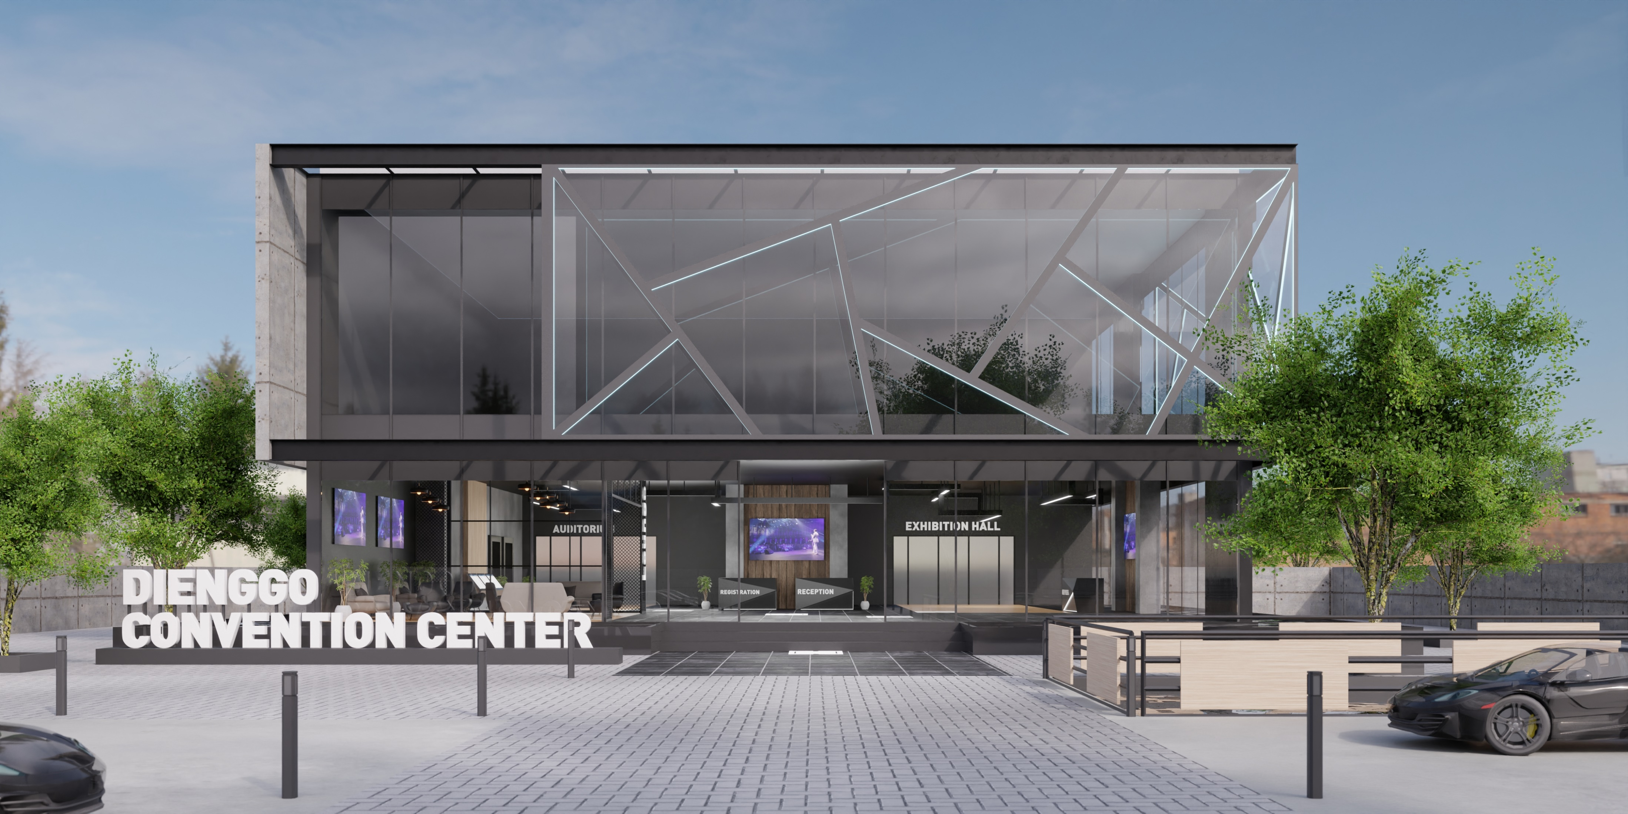
Landing – Front Building

Slide 2
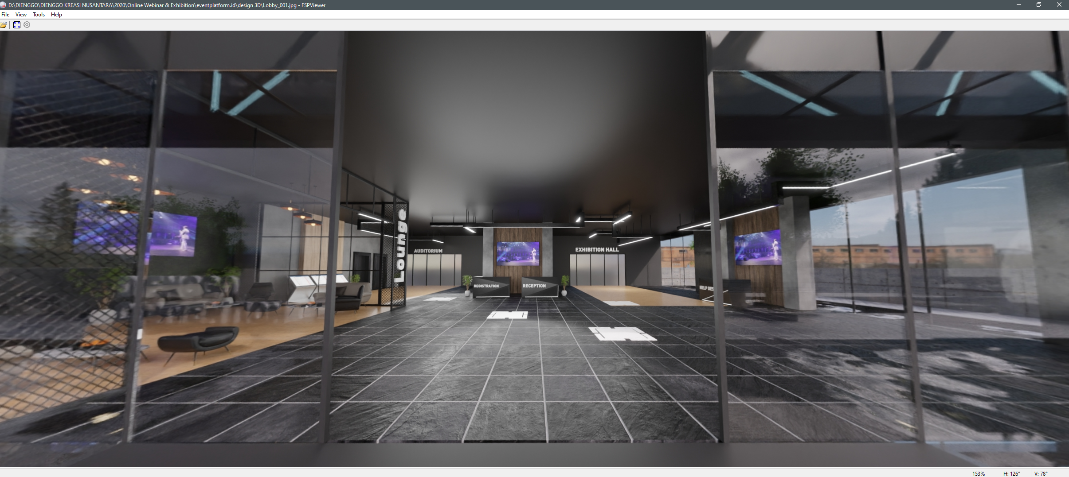
Lobby
Lobby_004
Lobby_005
Lobby_002
Lobby_003

Slide 3
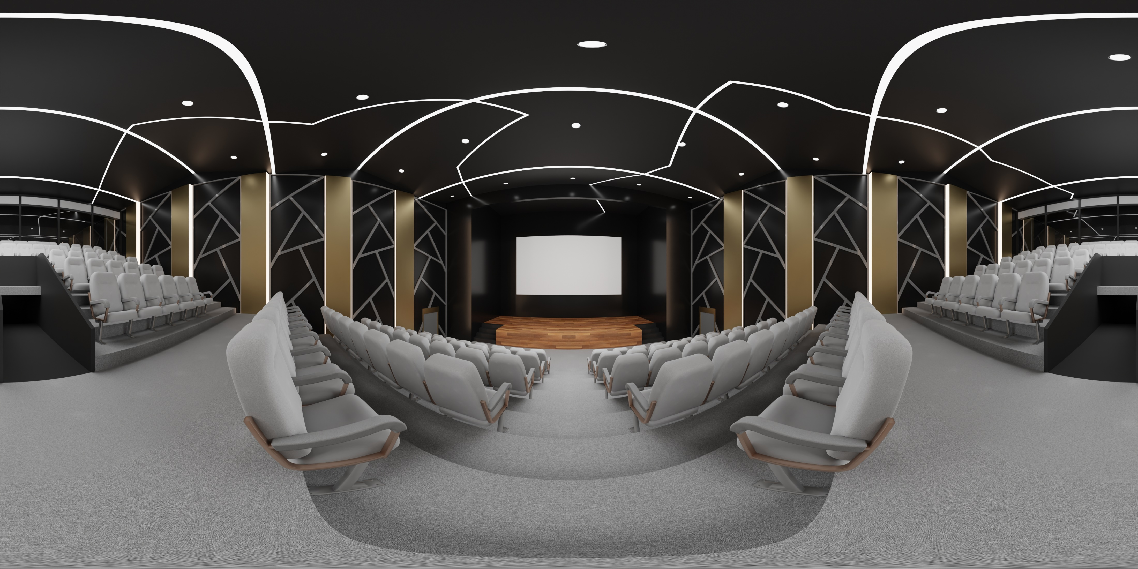
Auditorium

Slide 4
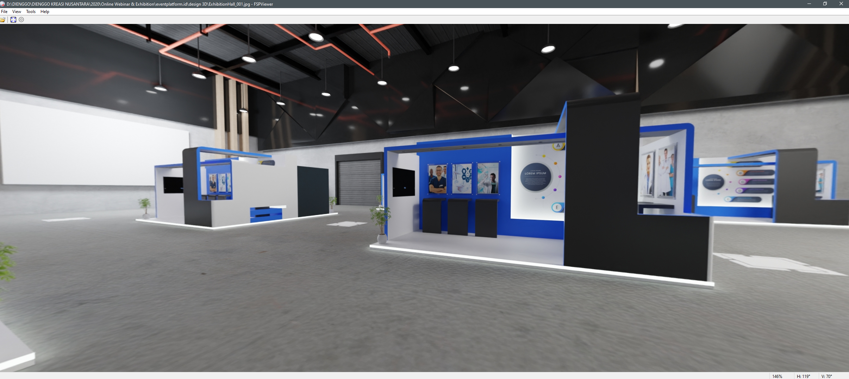
Booth Hall – ExhibitionHall_001
ExhibitionHall_004
ExhibitionHall_003
ExhibitionHall_002

